Slide 1

understanding Turnover

Slide 2
AGENDA
Two distinct approaches
Data & Models Summary
Individual turnover Drivers
Aggregate Trends Drivers

Slide 3
Two predictive modeling techniques help us apply descriptive analytics to understand turnover
Individual Behavior Model
Aggregate Trend Model
By using detailed individual factors to train advanced models we can understand:
Who is likely to resign?
Why did [employee] leave?
What levers do we have to minimize the risk of turnover?
By aggregating what we know about our staff at location, store and year levels, we can use advanced modeling techniques to attempt to understand:
Why did X% of my staff leave last year?
What is driving my location’s turnover?
How can I begin to minimize my store’s turnover risk?

Slide 4
Data Sources
Distinct problems require distinct approaches-
To accommodate both types of use cases, I’ve developed two approaches, both using fictional HR data as a base from Kaggle:
Sample Individual HR data from here
Demographic information (i.e age, gender, education, distance from work)
Role requirements (i.e department, education field
Sample aggregate HR data from here
Required manual aggregation into city, store number, and year
Joined with some publicly available from the US Bureau of Labor Statistics, and St. Louis Federal Reserve to attempt to model overall macroeconomic trends (i.e real median wages, job openings, avg hire rates)
*See fictional dataset used

Slide 5
Model overview
Both models are unique, but leverage boosting techniques
Individual model: CatBoost classifier predicting if employee leaves or stays
Aggregate model: XGBoost Regressor predicting store’s annual turnover rate
Boosting model rough overview-
Imagine I give a room of 100 people some data to sequentially predict if it will rain in the next hour 1000 times. Each person can observe the other’s predictions and attempt to account for others’ mistakes.
At first, I average predictions together to aggerate them. Over the course of the 1000 times, I can observe who appears to perform worse, and who appears to perform better and create a weighted sum of everyone's predictions based on their performance to create as strong a model as possible.
This is how Boosting models work, only its 100 models instead of people, and it goes way faster, with less arguing!
By summarizing how each sub model’s predictions changed based on the given data (i.e. marginal impact of adding a given feature), we can use these advanced modeling techniques to provide descriptive analytics on why the model thinks turnover will be 3% or that employee id 24 will resign.

Slide 6
individual model results

Slide 7
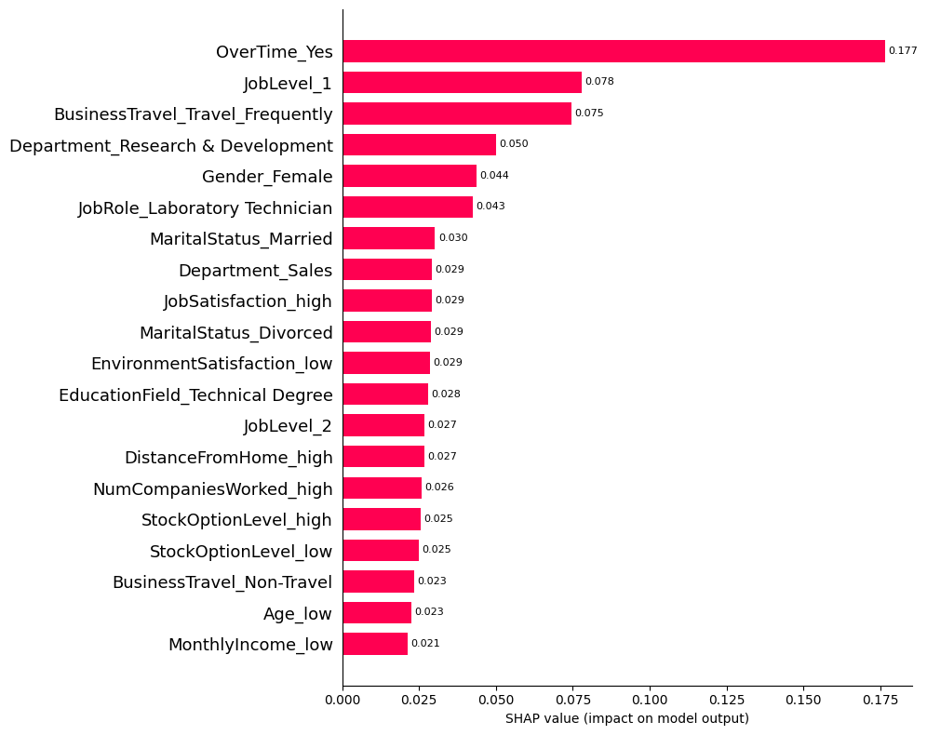
Feature importance
Top drivers of employee turnover appear to be overtime, entry level positions and travel
Overtime appears to on average change the likelihood of employees resigning by ~18%
Entry level appears to impact
Frequent business Travel on average impacts 7.5% of resignations
This measures magnitude, rather than direction (i.e this overtime is most impactful, but this does not say overtime increases resignations)
What factors are most impactful to an individual’s turnover?
Based on the weighted average absolute value of each features marginal contribution

Slide 8
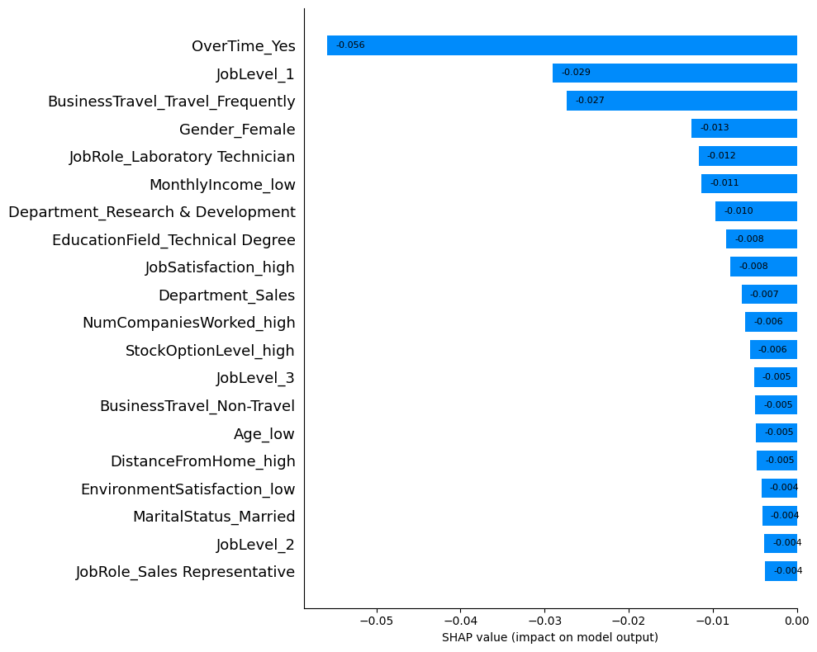
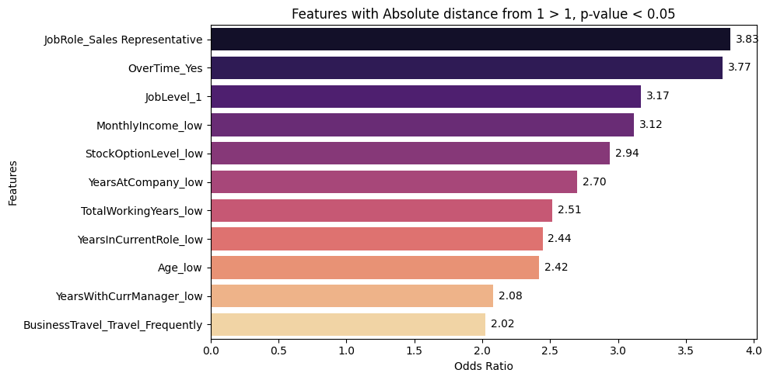
Feature relationships
Our top drivers (overtime, entry level positions and travel) of employee turnover appear at the top again, and all appear to increase the likelihood of resignations
We can also use odds ratios from a chi squared contingency test to depict this relationship:
From this, we can see that over time makes employees 3.7 times as likely to resign!
Entry level employees are 3.2 times as likely
Frequent business travelers are 2 times as likely
How do these features impact an individual’s turnover?
Based on the weighted average value of each features marginal contribution

Slide 9
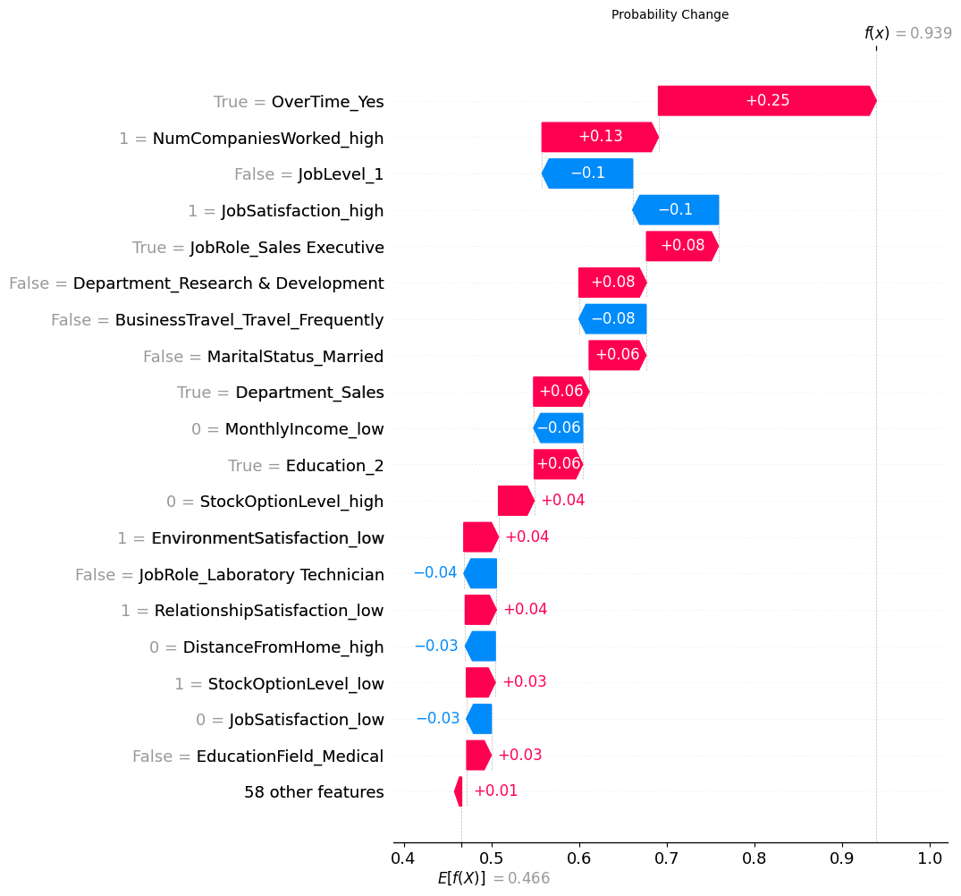
Individual insights
Why did [person] resign?
Based on the features marginal contribution to the overall prediction
Another benefit of this model, is we can examine how each feature impacted a given final prediction
In this example, we can see again how large the impact of overtime is to the probability of resignation for a specific person
Overtime increased the probability that this employee would resign by 25 percentage points!
These insights can inform our decision making- is the value from this employee’s overtime work worth the added risk of their resignation?

Slide 10
Potential model improvements
All number features were converted into categorical variables for easy interpretation- wages were translated from actual wages to `high` wages or `low` wages
This was not sophisticated in its approach
Wages are high/low with respect to the job market and specific requirements of the role
Understanding how an additional marginal dollar or percentage increase in wage might impact the likelihood of resignation is useful, but this model cannot provide that with this technique
Additional factors might drive turnover exogenous to the model
Potential features might include
Sentiment analysis on any available natural language from employees
Recent increases in sick/PTO/vacation days might provide and early indication of potential turnover
Social network graph analysis might provide some useful insight on how specific managers or teams effect the likelihood of turnover
Some feature depicting resignation momentum may improve the model – recent increased resignations might increase the likelihood of following
Lack of seasonal awareness or trend in the model – staffing planning might benefit from some understanding of how seasons impact resignations

Slide 11
Aggregate model results

Slide 12
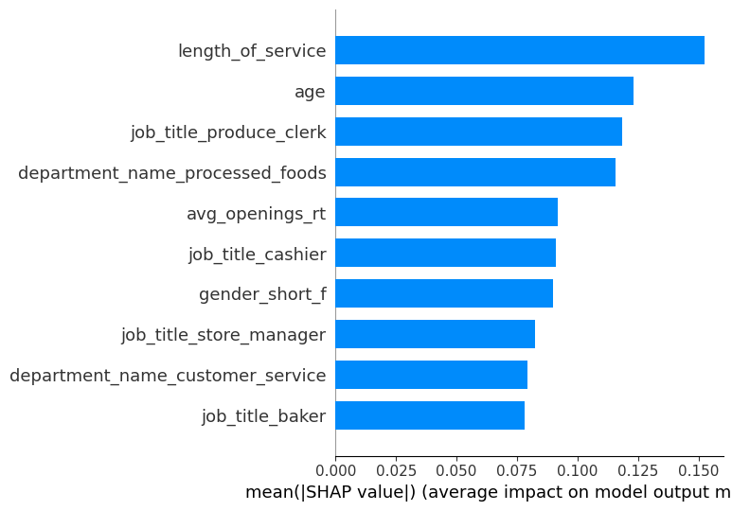
Feature importance
The trend has less detailed data than the individual model’s sampled data, however there is more sample
To get the data in terms of city / store / year
The trend model has different inputs- it seems like the top 4 are the store’s average length of service, age, percentage of workforce that are produce clerks or work in processed foods
What factors are most impactful a stores annual turnover?
Based on the weighted average absolute value of each features marginal contribution

Slide 13
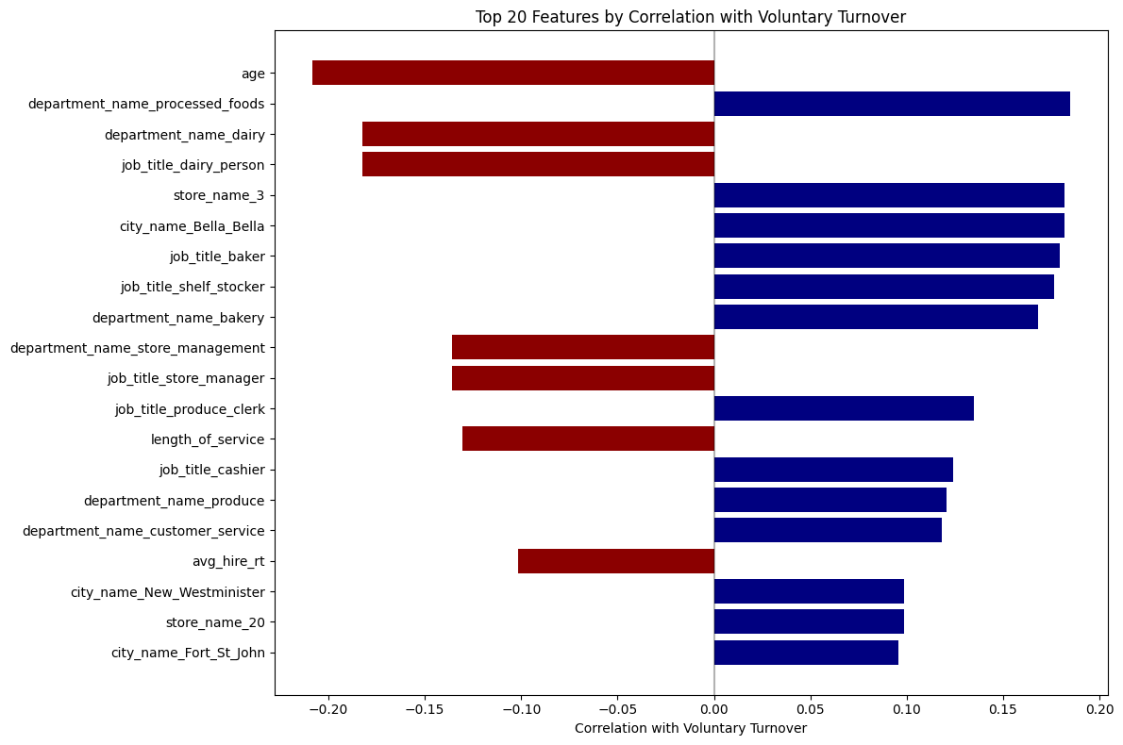
Feature importance
Next, we can view correlations to understand how the model might apply these features
It seems the higher the stores average age, the less expected turnover
The percentage of processed food employees increases the estimated turnover
As percentage of produce clerks increase, the turnover rate increases
How do these features impact a stores annual turnover?
Based on the Pearsons correlations between features and annual turnover

Slide 14
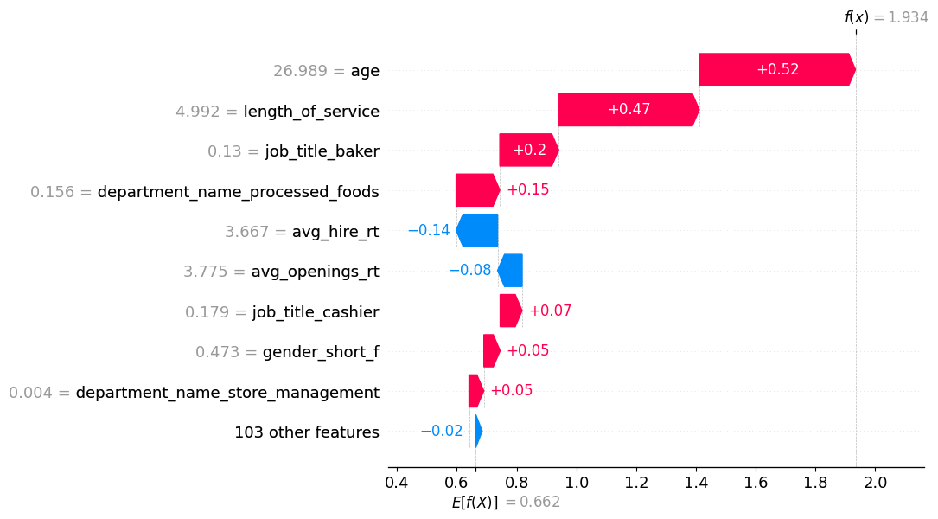
Why did my store have this turnover?
Like the individual model, we can use this technique to highlight why the model expects a given turnover for a store/year/location
In the example of store 44 in Vancouver in 2015, we can see that the average age of the workforce drives the expected turnover much higher, as well as the length of service.
Why did store 44 in Vancouver have this turnover in 2015?
Based on the shap values for the model’s predicted turnover

Slide 15
APPENDIX

Slide 16
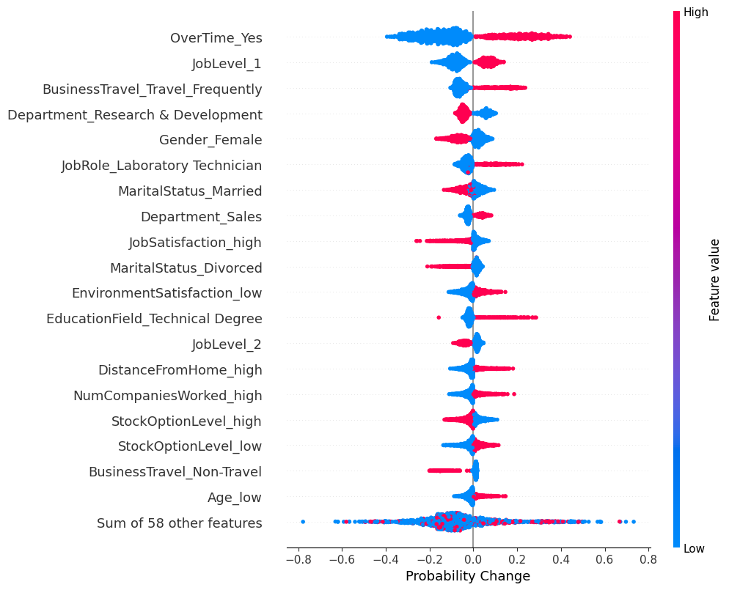
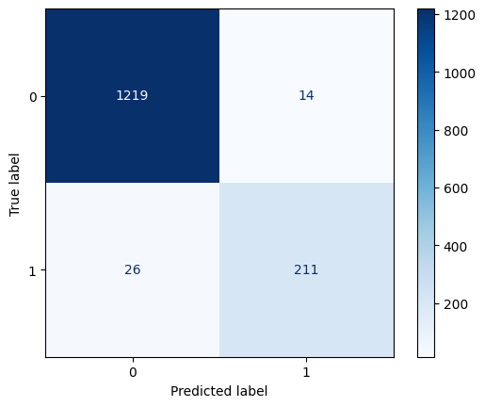
Individual model details
Individual model beeswarm
Here each sample (employee) is plotted in a distribution where the color is the value of the feature (high = red) and the x-axis is the features marginal change to the prediction
Individual model confusion matrix
Model had 86% accuracy in predicting employee turnover,
capturing 89% of overall actual turnover
Predicted
Remain Resigned
Actual
Resigned Remain

Slide 17
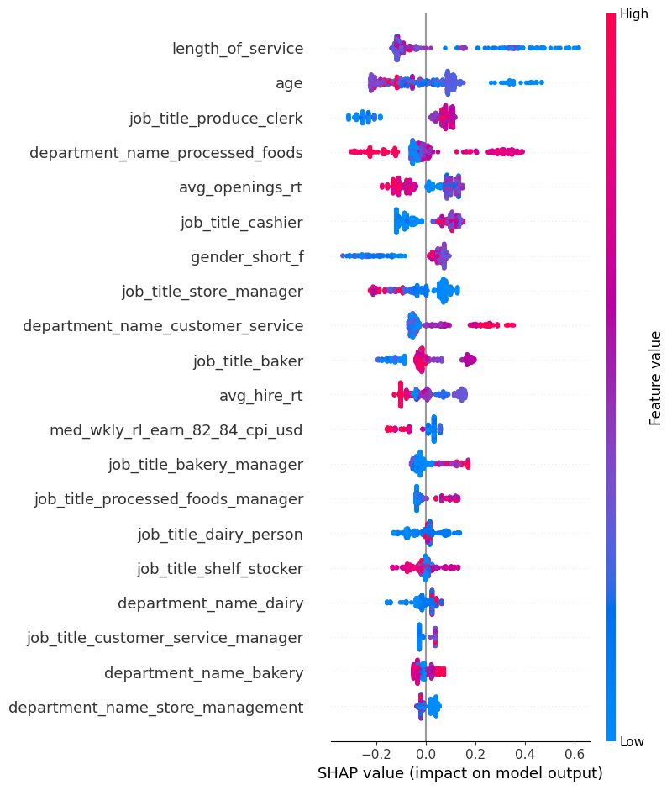
Trend model beeswarm
Here each sample (city, store, year) is plotted in a distribution where the color is the value of the feature (high = red) and the x-axis is the features marginal change to the prediction

Slide 18
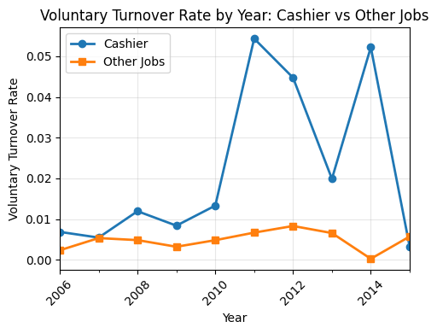
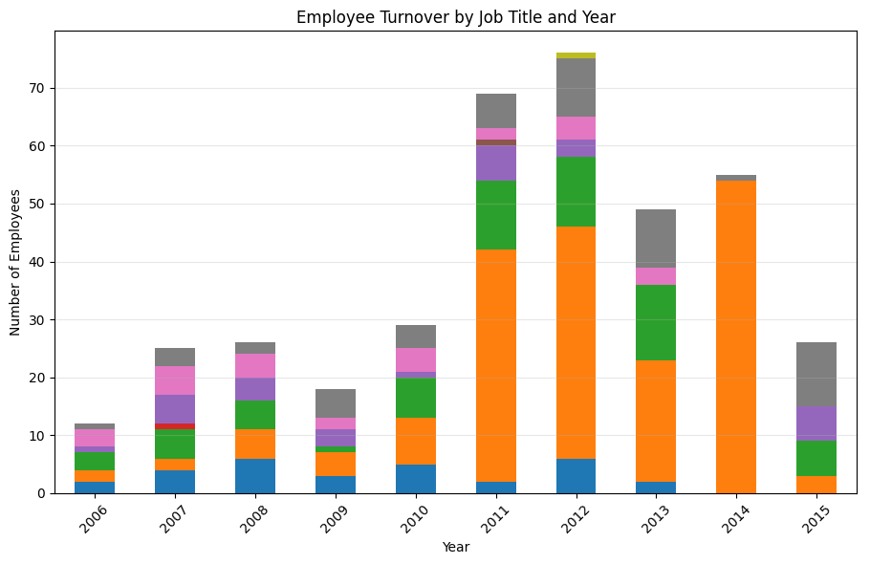
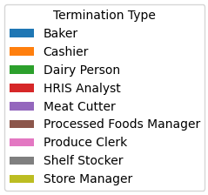
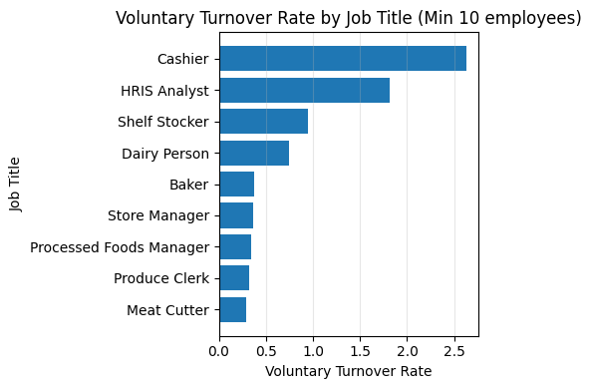
Trend Dataset: Cashier resignations climbing

Slide 19
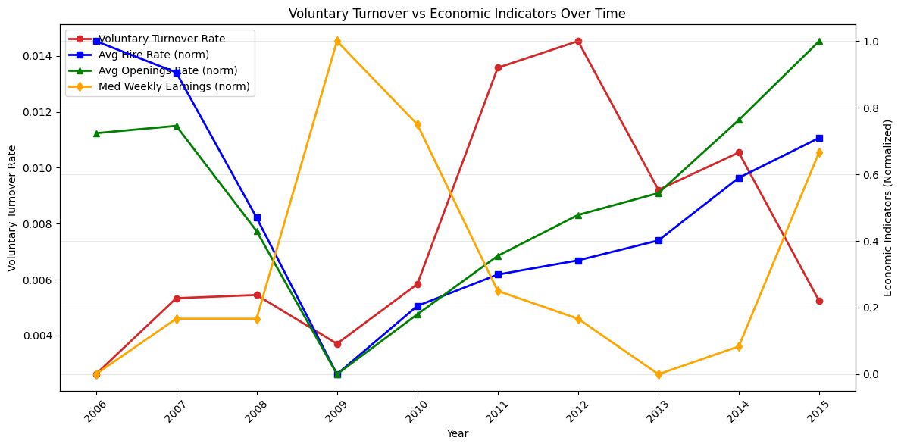
Economic Indicators by Resignations
At this aggregated level, the relationships between these features are unintuitive, requiring more analysis at a lower level of detail for valuable insights

Slide 20
Dynamic delivery
METRIC | MEASUREMENT | TARGET | ACTUAL
Audience attendance | # of attendees | 150 | 120
Engagement duration | Minutes | 60 | 75
Q&A interaction | # of questions | 10 | 15
Positive feedback | Percentage (%) | 90 | 95
Rate of information retention | Percentage (%) | 80 | 85
Learn to infuse energy into your delivery to leave a lasting impression
One of the goals of effective communication is to motivate your audience

Slide 21
Final tips & takeaways
Practice makes perfect
Continue improving
Consistent rehearsal
Strengthen your familiarity
Refine delivery style
Pacing, tone, and emphasis
Timing and transitions
Aim for seamless, professional delivery
Practice audience
Enlist colleagues to listen & provide feedback
Seek feedback
Reflect on performance
Explore new techniques
Set personal goals
Iterate and adapt

Slide 22
Speaking engagement metrics
IMPACT FACTOR | MEASUREMENT | TARGET | ACHIEVED
Audience interaction | Percentage (%) | 85 | 88
Knowledge retention | Percentage (%) | 75 | 80
Post-presentation surveys | Average rating | 4.2 | 4.5
Referral rate | Percentage (%) | 10 | 12
Collaboration opportunities | # of opportunities | 8 | 10

